Slide 1
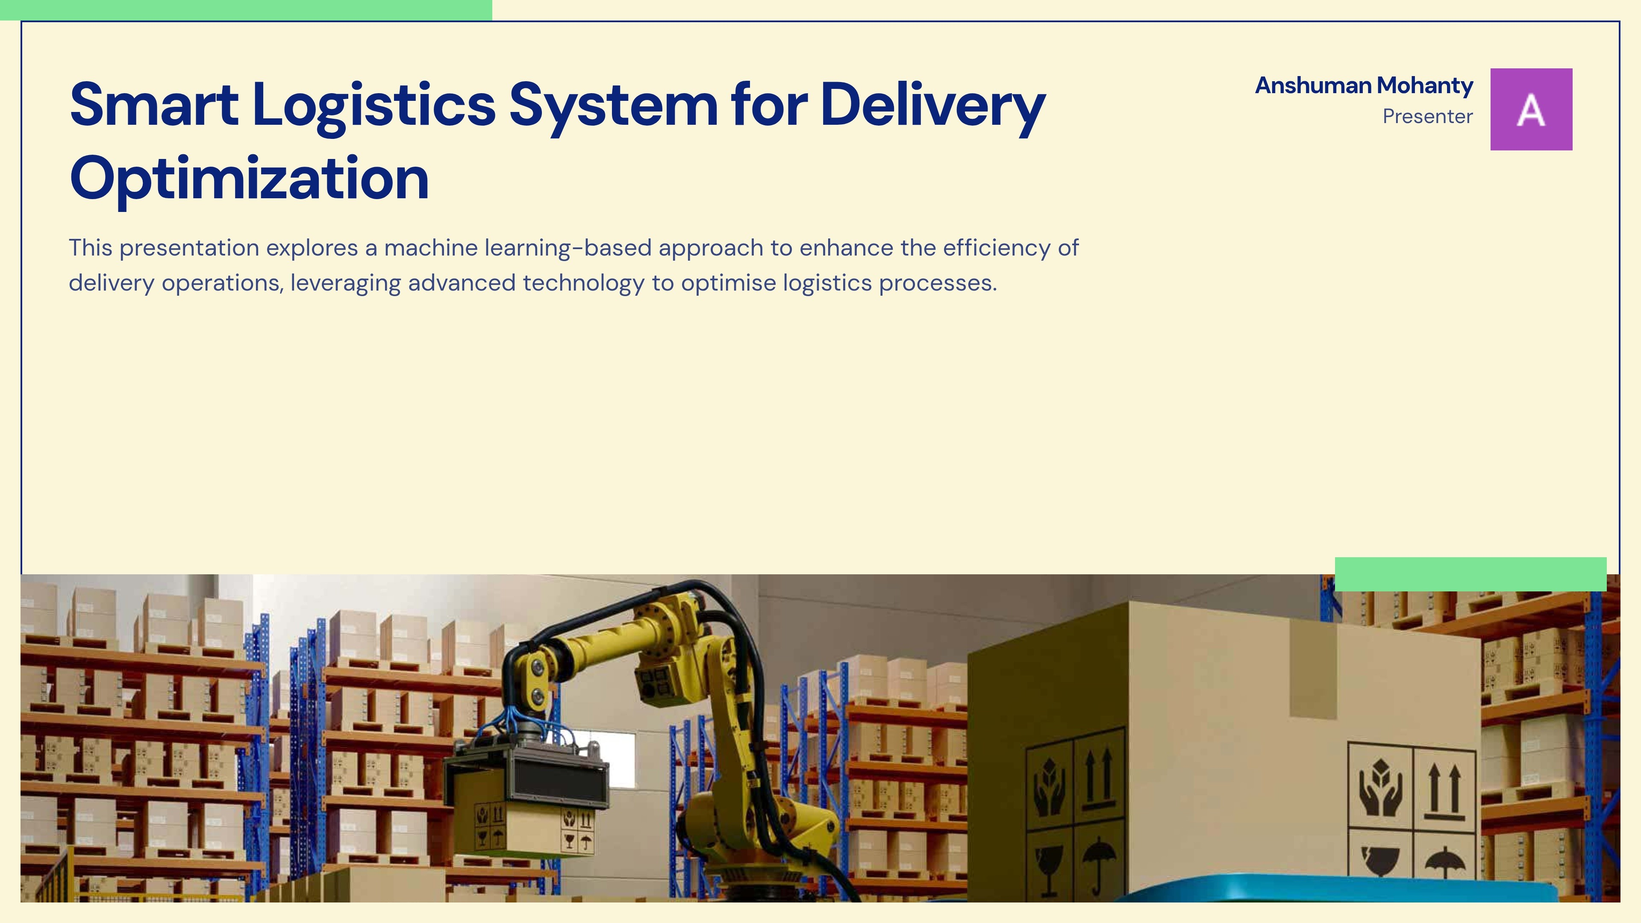


Slide 2




Team Members:
Aditya Kumar Nayak(22CSE537)
Anshuman Mohanty(22CSE56)
Sibo Sankar Panda(22CSE79)

Slide 3

Objectives
1
Optimize Delivery Efficiency
Reduce delays with AI-powered route planning.
2
Scheduling & Cost Prediction
Suggest best time slots & pricing based on real-time factors.
3
Proposing the best distance on the basis of ML
Keep customers updated about package status.
4
Flexible Rescheduling & Priority Delivery
Users can modify delivery times.
5
Proposing the mechanism of smart delivery and Decision Making.
Help delivery personnel manage orders efficiently.

Slide 4
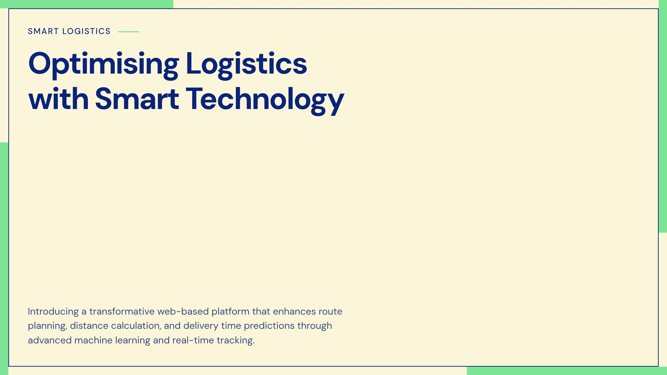

Slide 5
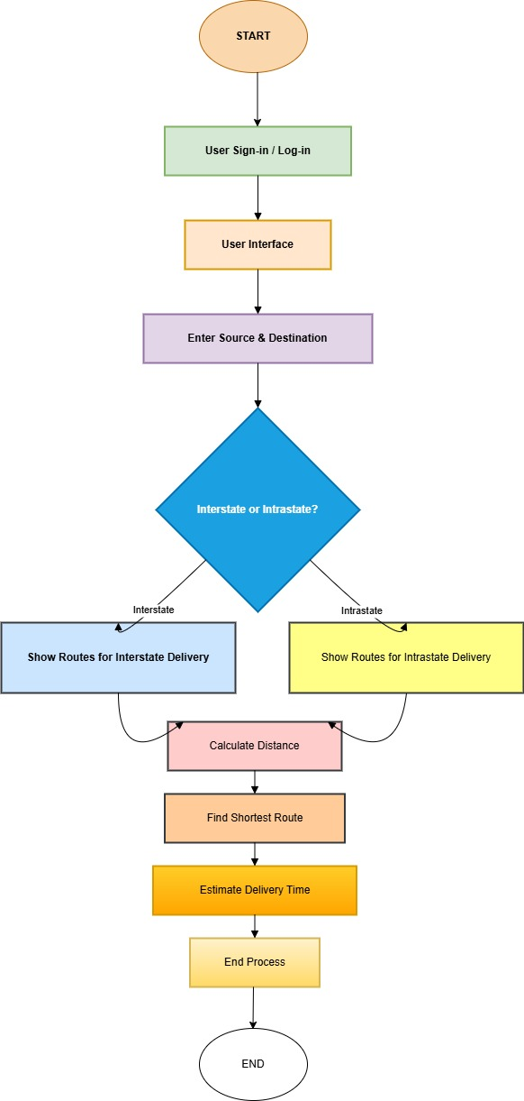
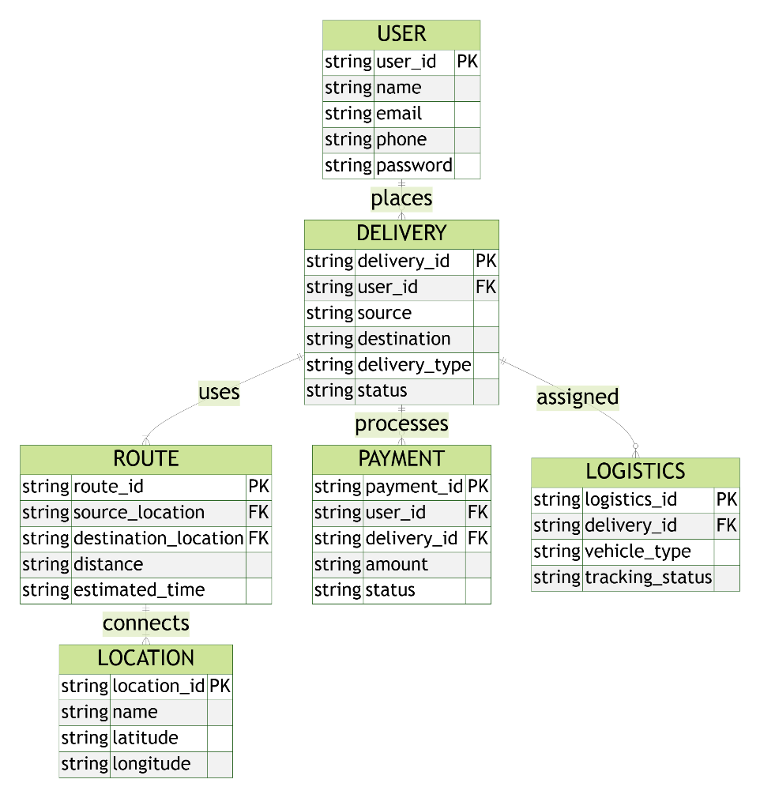

Important Diagrams:

Slide 6
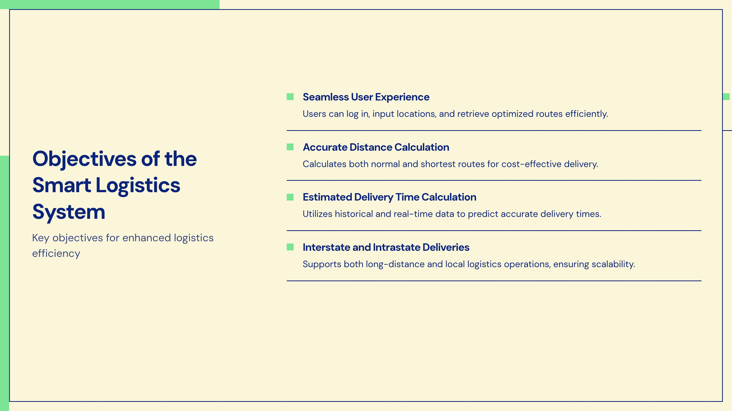

Slide 7
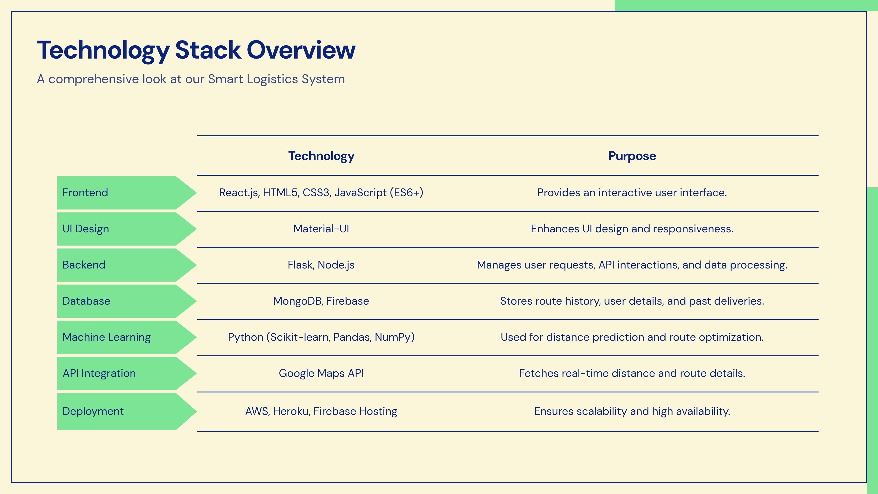

Slide 8
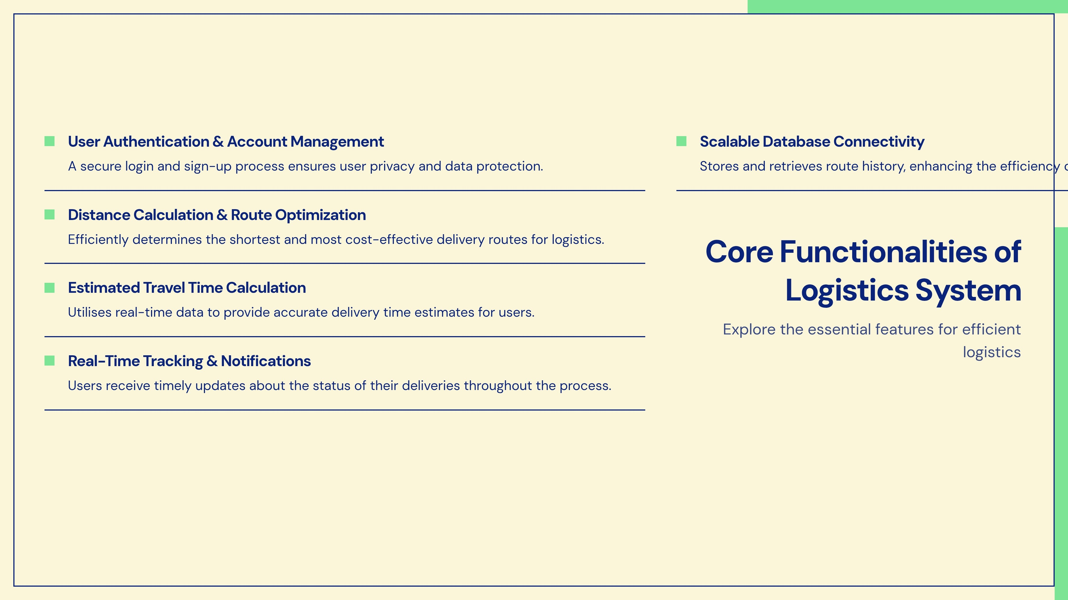

Slide 9
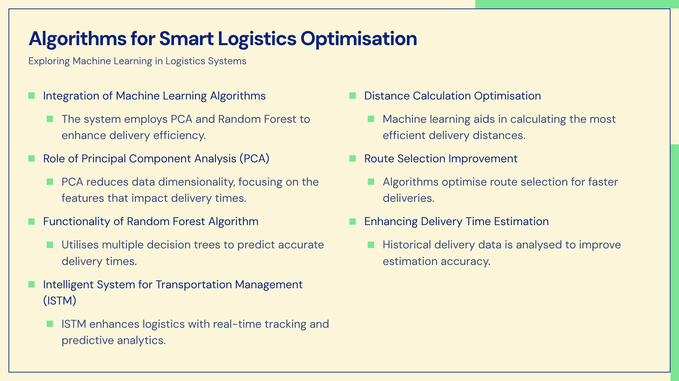

Slide 10
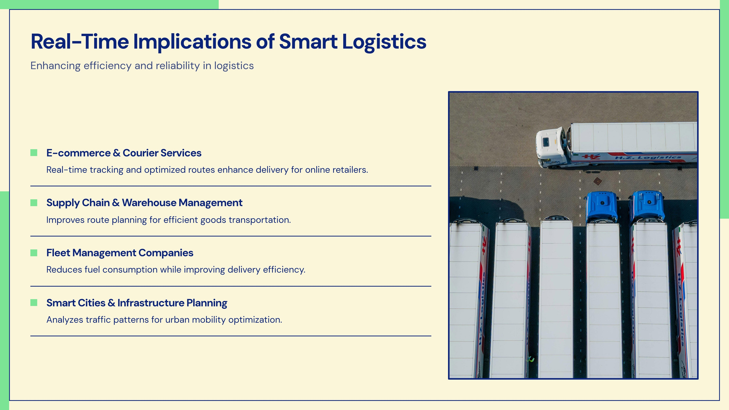

Slide 11
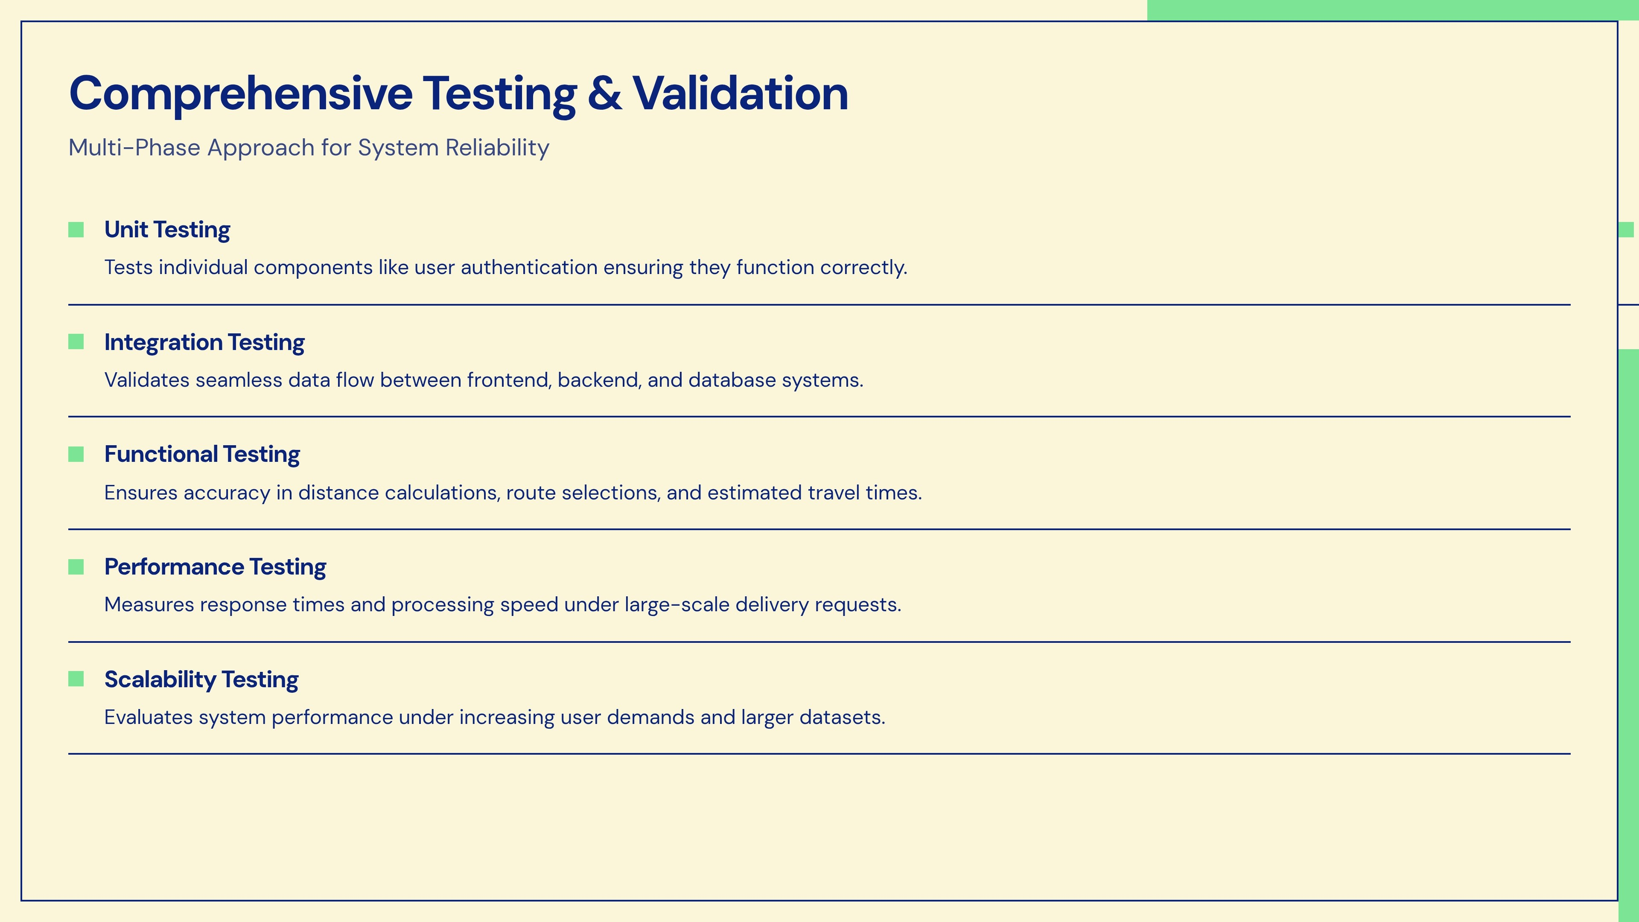

Slide 12
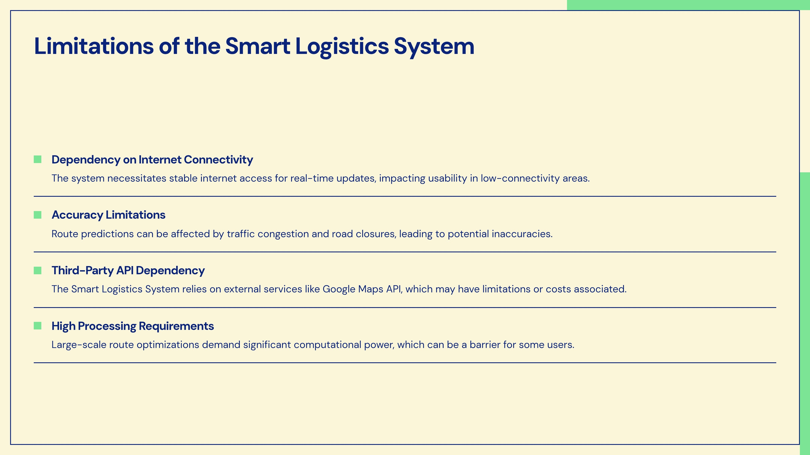

Slide 13
Development Progress
1
100% Complete(building the logic of smart delivery procedure)
Web development is underway. Frontend is done.
2
Completion of ML integration with fronted , database
ML model integration required.
3
Performing calculative distance between pre defined routes and fetch it by extracting from Data set.

